Slide 1
Query Processing
Overview
Measures of Query Cost
Selection Operation
Sorting
Join Operation
Other Operations
Evaluation of Expressions

Slide 2
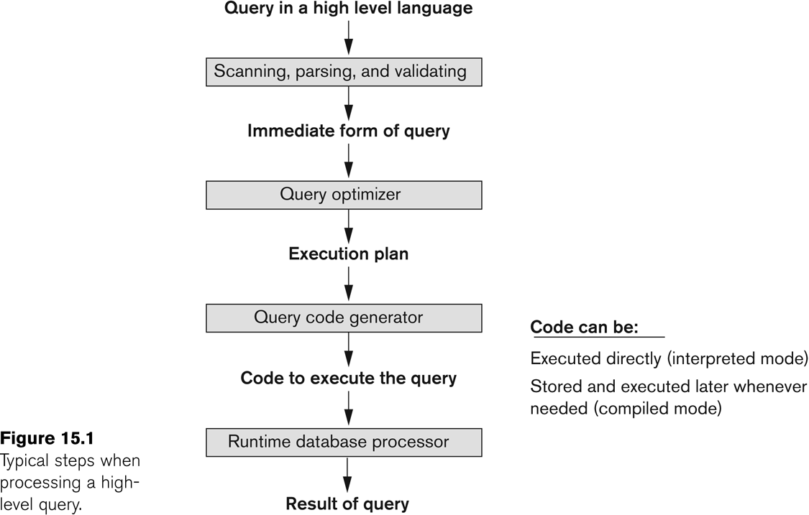
Introduction to Query Processing

Slide 3
Basic Steps in Query Processing
1. Parsing and translation
2. Optimization
3. Evaluation

Slide 4
Basic Steps in Query Processing (Cont.)
Parsing and translation
translate the query into its internal form. This is then translated into relational algebra.
Parser checks syntax, verifies relations
Evaluation
The query-execution engine takes a query-evaluation plan, executes that plan, and returns the answers to the query.

Slide 5
Basic Steps in Query Processing : Optimization
A relational algebra expression may have many equivalent expressions
E.g., σ_{salary<75000}(∏_{salary}(instructor)) is equivalent to ∏_{salary}(σ_{salary<75000}(instructor))
Each relational algebra operation can be evaluated using one of several different algorithms
Correspondingly, a relational-algebra expression can be evaluated in many ways.
Annotated expression specifying detailed evaluation strategy is called an evaluation-plan.
E.g., can use an index on salary to find instructors with salary < 75000,
or can perform complete relation scan and discard instructors with salary ≥ 75000

Slide 6
Translating SQL Queries into Relational Algebra
Query block:
The basic unit that can be translated into the algebraic operators and optimized.
A query block contains a single SELECT-FROM-WHERE expression, as well as GROUP BY and HAVING clause if these are part of the block.
Nested queries within a query are identified as separate query blocks.
Aggregate operators in SQL must be included in the extended algebra.

Slide 7
Translating SQL Queries into Relational Algebra (2)
SELECT LNAME, FNAME
FROM EMPLOYEE
WHERE SALARY > ( SELECT MAX (SALARY)
FROM EMPLOYEE
WHERE DNO = 5);
SELECT LNAME, FNAME
FROM EMPLOYEE
WHERE SALARY > C
SELECT MAX (SALARY)
FROM EMPLOYEE
WHERE DNO = 5
π_{LNAME, FNAME} (σ_{SALARY>C}(EMPLOYEE))
ℱ_{MAX SALARY} (σ_{DNO=5} (EMPLOYEE))

Slide 8
Basic Steps: Optimization (Cont.)
Query Optimization: Amongst all equivalent evaluation plans choose the one with lowest cost.
Cost is estimated using statistical information from the database catalog
e.g. number of tuples in each relation, size of tuples, etc.
In this module we study
How to measure query costs
Algorithms for evaluating relational algebra operations
How to combine algorithms for individual operations in order to evaluate a complete expression
We study how to optimize queries, that is, how to find an evaluation plan with lowest estimated cost

Slide 9
Measures of Query Cost
Cost is generally measured as total elapsed time for answering query
Many factors contribute to time cost
disk accesses, CPU, or even network communication
Typically disk access is the predominant cost, and is also relatively easy to estimate. Measured by taking into account
Number of seeks * average-seek-cost
Number of blocks read * average-block-read-cost
Number of blocks written * average-block-write-cost
Cost to write a block is greater than cost to read a block
data is read back after being written to ensure that the write was successful

Slide 10
Measures of Query Cost (Cont.)
For simplicity we just use the number of block transfers from disk and the number of seeks as the cost measures
t_{T} – time to transfer one block
t_{S} – time for one seek(block access + rotational latency)
Cost for b block transfers plus S seeks b * t_{T} + S * t_{S}
We ignore CPU costs for simplicity
Real systems do take CPU cost into account
We do not include cost to writing output to disk in our cost formulae

Slide 11
Measures of Query Cost (Cont.)
Several algorithms can reduce disk IO by using extra buffer space
Amount of real memory available to buffer depends on other concurrent queries and OS processes, known only during execution
We often use worst case estimates, assuming only the minimum amount of memory needed for the operation is available
Required data may be buffer resident already, avoiding disk I/O
But hard to take into account for cost estimation
Notes:
11

Slide 12
Selection Operation
File scan
Algorithm A1 (linear search). Scan each file block and test all records to see whether they satisfy the selection condition.
Cost estimate = b_{r} block transfers + 1 seek(initial seek to access 1st block)
b_{r} denotes number of blocks containing records from relation r
Cost= t_{s} + b_{r *} t_{t}
If selection is on a key attribute, can stop on finding record
cost = (b_{r} /2) block transfers + 1 seek
Linear search can be applied regardless of
selection condition or
ordering of records in the file, or
availability of indices

Slide 13
Algorithm A2 (binay search):if file is ordered on an attribute and selection condition is an equality comparison on the attribute
Worst case:
Block access: Ceil(log₂ (b_{r}))
Each block access required disk seek ( t_{T} + t_{S} )
Total time cost = Ceil(log₂ (b_{r}))*( t_{T} + t_{S} )
Note: binary search generally does not make sense since data is not stored consecutively
except when there is an index available,
and binary search requires more seeks than index search

Slide 14
Selections Using Indices
Index scan – search algorithms that use an index
selection condition must be on search-key of index.
A3 (primary index, equality on key). Retrieve a single record that satisfies the corresponding equality condition
Cost = (h_{i} + 1) * (t_{T} + t_{S})
A4 (primary index, equality on nonkey) Retrieve multiple records.
Records will be on consecutive blocks
Let b = number of blocks containing matching records
Cost = h_{i} * (t_{T} + t_{S}) + t_{S} + t_{T} * b

Slide 15
Selections Using Indices
A5 (secondary index, equality on nonkey).
Retrieve a single record if the search-key is a candidate key
Cost = (h_{i} + 1) * (t_{T} + t_{S})
Retrieve multiple records if search-key is not a candidate key
each of n matching records may be on a different block
Cost = (h_{i} + n) * (t_{T} + t_{S})
Can be very expensive if large no of record retrieved!
Notes:
15

Slide 16
Selections Involving Comparisons
Can implement selections of the form σ_{A≤V} (r) or σ_{A ≥ V}(r) by using
a linear file scan,
or by using indices in the following ways:
A6 (primary index, comparison). (Relation is sorted on A)
For σ_{A ≥ V}(r) use index to find first tuple ≥ v and scan relation sequentially from there
For σ_{A≤V} (r) just scan relation sequentially till first tuple > v; do not use index
A7 (secondary index, comparison).
For σ_{A ≥ V}(r) use index to find first index entry ≥ v and scan index sequentially from there, to find pointers to records.
For σ_{A≤V} (r) just scan leaf pages of index finding pointers to records, till first entry > v
In either case, retrieve records that are pointed to
requires an I/O for each record
Linear file scan may be cheaper

Slide 17
Implementation of Complex Selections
Conjunction: σ_{θ1}∧ _{θ2}∧. . . _{θn}(r)
A7 (conjunctive selection using one index).
Select a combination of θ_{i} and algorithms A1 through A7 that results in the least cost for σ_{θi} (r).
Test other conditions on tuple after fetching it into memory buffer.
A8 (conjunctive selection using composite index).
Use appropriate composite (multiple-key) index if available.
A9 (conjunctive selection by intersection of identifiers).
Requires indices with record pointers.
Use corresponding index for each condition, and take intersection of all the obtained sets of record pointers.
Then fetch records from file
If some conditions do not have appropriate indices, apply test in memory.

Slide 18
Algorithms for Complex Selections
Disjunction:σ_{θ1}∨ _{θ2} ∨. . . _{θn} (r).
A10 (disjunctive selection by union of identifiers).
Applicable if all conditions have available indices.
Otherwise use linear scan.
Use corresponding index for each condition, and take union of all the obtained sets of record pointers.
Then fetch records from file
Negation: σ_{¬θ}(r)
Use linear scan on file
If very few records satisfy ¬θ, and an index is applicable to θ
Find satisfying records using index and fetch from file

Slide 19
Sorting
We may build an index on the relation, and then use the index to read the relation in sorted order. May lead to one disk block access for each tuple.
For relations that fit in memory, techniques like quicksort can be used. For relations that don’t fit in memory, external sort-merge is a good choice.

Slide 20
Algorithms for External Sorting (1)
External sorting:
Refers to sorting algorithms that are suitable for large files of records stored on disk that do not fit entirely in main memory, such as most database files.
Sort-Merge strategy:
Starts by sorting small subfiles (runs) of the main file and then merges the sorted runs, creating larger sorted subfiles that are merged in turn.
Sorting phase: n_{R} = ⎡(b/n_{B})⎤
Merging phase: d_{M} = Min (n_{B}-1, n_{R});
n_{P} = ⎡(log_{dM}(n_{R}))⎤
n_{R}: number of initial runs; b: number of file blocks;
n_{B}: available buffer space; d_{M}: degree of merging(no of runs merge in each pass);
n_{P}: number of passes.

Slide 21
Ex:
No of blocks nb=5
Size of file b=1024 blocks
No of Initial run nr=b/nb=1024/5=205
Dm=4
Pass-1 result 52 run
Pass-2 result 13 run
Pass-3 result 4 run
Pass-4 result 1 run
Complexity: no of block access
(2*b)+(2*(b*logdmnr))

Slide 22
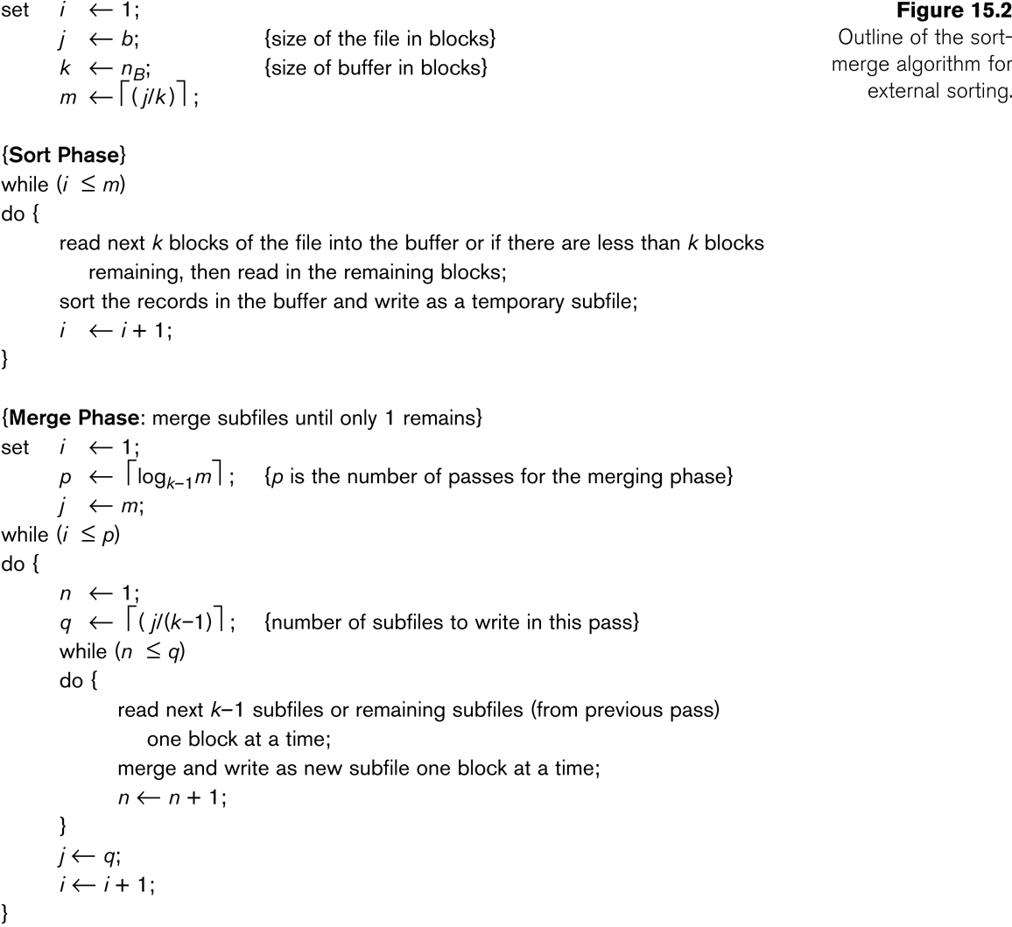
Algorithms for External Sorting (2)

Slide 23
Example: External Sorting Using Sort-Merge

